Slide 1
Signals and Classifications of Signals
Signals and Systems Fall 2020
Prof. Dr. Adnan Kavak
Computer Engineering
Kocaeli University
Textbook: Linear Systems and Signals, B.P. Lathi
This slides are used in EE313 course at the University of Texas at Austin.
They are adopted in this course with Courtesy of Prof. Brian L. Evans

Slide 2
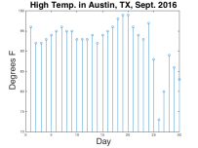
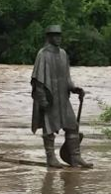

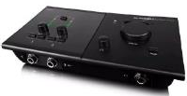

Basic Definitions
SRV statue Austin, TX
Signal
Carries information
Patterns of variations in physical quantity
Function of independent variable (time, etc)
Signal processing signalprocessingsociety.org
Generation, transformation and extraction of information
Algorithms with associated architectures and implementations
Applications related to processing information
By Scot Duke
System
Manipulates, changes, records or transmits signals
Converts a signal into another
Audio mixing board
IP camera
Wi-Fi access point

Slide 3
Examples of Signals : 1-ElectroEncephaloGram (EEG) Signal

Slide 4
Examples of Signals: 2-Stock Market Data

Slide 5
Examples of Signals: 3-Brain MR

Slide 6
Classification of Signals
Any signal can be classified as;
Continuous Time vs. Discrete Time Signals
Analog vs. Digital Signals
Deterministic vs. Random Signals
Periodic vs. Aperiodic Signals
Even vs. Odd Signals
Energy vs. Power Signals

Slide 7

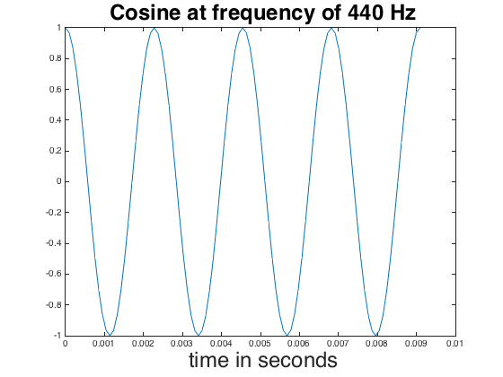
Continuous time vs. Discrete time Signals
Continuous-time signals
x(t): where t can take any real value
x(t) may be 0 for range of values of t
Amplitude values maybe real or complex number
Discrete-time signals
x[n]: where n ∈ {...-3,-2,-1,0,1,2,3...}
Unitless sample index n (e.g. day)
Amplitude values may be real or complex number

Slide 8
Continuous Time vs. Discrete Time Signals
Continuous-time signals
MATLAB Code:
f0 = 440;
fs = 24*f0;
Ts = 1/fs;
t = 0 : Ts : 4/f0;
x = cos(2*pi*f0*t); plot(t, x);
Discrete-time signals
MATLAB Code:
sep2016hightemp = [ 96, 92, 92, 93, 94, 95, 96, 95, 95, 93, 93, 93, 94, 92, 94, 95, 96, 98, 99, 99, 96, 94, 93, 97, 88, 73, 80, 89, 86, 83 ];
stem(sep2016hightemp);
title('High Temp. in Austin, TX, Sept. 2016');
xlabel('Day');
ylabel('Degrees F');
ylim( [70 100] );

Slide 9
Analog vs. Digital Signals
At each time value, analog signal amplitude takes real or complex value (a.k.a. continuous-valued)
Digital signal amplitude takes values from a discrete set (a.k.a. discrete-valued)
Analog continuous-time signal
1
Digital continuous-time signal
-1

Slide 10
Example

Slide 11
Deterministic vs. Random Signals
Deterministic signals
Mathematically described, e.g. x(t) = cos(2 π f₀ t)
Random signals
Cannot be predicted exactly or described by a formula
Probability distribution of amplitude values can be defined
Example: Flipping coin 10 times
Matlab code: uniform distribution
Trial #1
1
flip
-1
Trial #2
1
flipnumber = 1:10;
y = sign(randn(10,1));
stem(flipnumber, y);
flip
-1

Slide 12
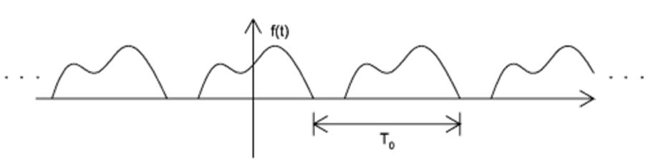
Periodic vs. Aperiodic Signals
A signal x(t) is periodic if for some positive constant T₀
x(t)=x(t+T₀) for all t,
Otherwise x(t) is aperiodic.
The smallest value of T₀ that satisfies perodicity condition of this equation is the fundamental period of x(t).
Fundamental frequency: f₀=1/T₀ (unit is Hertz –Hz)

Slide 13
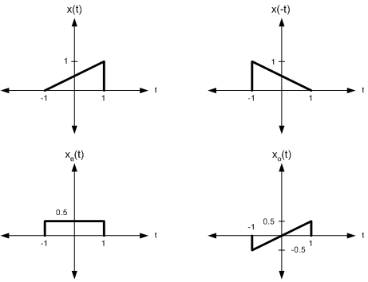
Even vs. Odd Signals
A signal x(t) is said to be even signal if x(t)=x(-t)
A signal x(t) is said to be odd signal if x(t)= - x(-t)
Any signal x(t) can be decomposed into even (x_{e}(t)) and odd x_{o}(t) parts
x_{e}(t)=(1/2)[x(t)+x(-t))]
x_{o}(t)=(1/2)[x(t)-x(-t))]
Even signal
Odd signal

Slide 14
Energy vs. Power Signals
Size of signal x(t)

Slide 15
Energy vs. Power Signals
If amplitude of x(t) does not approach zero as time goes to infinity, we should measure power P_{x} of x(t) instead:

Slide 16
Energy vs. Power Signals

Slide 17

Sinusoidal Signal
Mathematical form: A cos(ω₀ t + φ)
A is amplitude/magnitude
ω₀ is frequency in rad/s where ω₀ = 2 π f₀ and f₀ is in cycles/s or Hz
φ is phase shift in radians
Smallest period: T = 1 / f₀
Signal x(t) has period T if x(t+T) = x(t) for all t
Using property cos(x + 2π) = cos(x),
cos(2π f₀ (t + T)) = cos(2π f₀ t + 2π f₀ T) = cos(2π f₀ t)
when 2π f₀ T = 2π or when f₀ T = 1 or when T = 1 / f₀
When f₀ = 440 Hz, T = 2.27 ms
Play As Audio
f0 = 440;
fs = 8000;
Ts = 1/fs;
t = 0 : Ts : 3;
x = cos(2*pi*f0*t);
sound(x, fs);

Slide 18
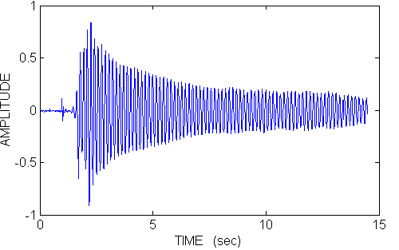
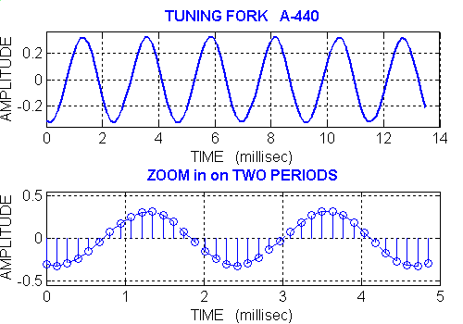
Tuning Fork Example A-440 Hz
Estimate Period
Middle plot below gives T ≈ 8.15ms – 5.85ms = 2.3ms
Bottom plot below gives
T ≈ (2 + 2/7) ms = 2.28ms
Estimate Frequency
f₀ = 1 / T = 1 / (2.3ms) = 435 Hz
f₀ = 1 / T = 1 / (2.28ms) = 438 Hz
©2003-2016, JH McClellan & RW Schafer

Slide 19
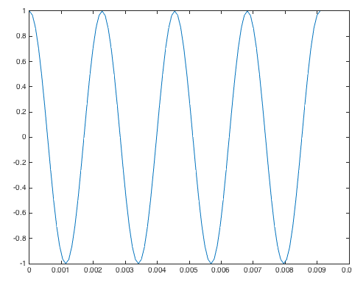
MATLAB Interlude
Matrix Laboratory (MATLAB)
Released in 1984 to universities
First toolboxes in control systems and signal processing (1987)
Semicolon prevents printing result
Scalar variables
Generating vectors
start : inc : end generate values from start to end at increments of inc
1 : 0.5 : 3 gives vector [1.0 1.5 2.0 2.5 3.0]
Plot vector x vs. vector t
% Scalar variables
f0 = 440;
fs = 24*f0;
Ts = 1/fs;
% Generate four periods % of time samples
t = 0 : Ts : 4/f0;
% Apply cosine to every
% element of 2 pi f0 t
x = cos(2*pi*f0*t);
plot(t, x);

Slide 20
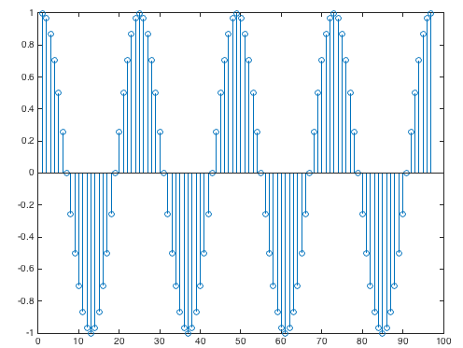
MATLAB Interlude
Plot individual samples as stems
Sound card on platform
Supports specific sampling rates, such as
8000 Hz for speech and audio
44100 Hz for CD audio
Playing sound in MATLAB
sound(vector, rate) will play values of vector at sampling rate and clip values lying outside [-1, 1]
soundsc(vector, rate) will scale values of vector to be in range [-1, 1] and play scaled values at sampling rate
stem(x);
f0 = 440;
fs = 8000; % rate
Ts = 1/fs;
t = 0 : Ts : 3; % 3 sec
x = cos(2*pi*f0*t);
sound(x, fs);

Slide 21
Systems
Systems operate on signals to produce new signals or new signal representations
Continuous-time system examples
y(t) = ½ x(t) + ½ x(t-1)
y(t) = x²(t)
Discrete-time system examples
y[n] = ½ x[n] + ½ x[n-1]
y[n] = x²[n]
x(t)
T{•}
y(t)
x[n]
T{•}
y[n]
Audio, image and communication applications for squaring block
Average of current input and delayed input is a simple filter

Slide 22
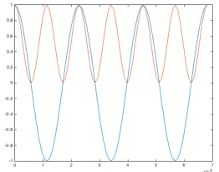
Squaring Block
Applications
Play AM radio audio transmission
Displayed pixels on screen undergo (•)^{2.2} nonlinearity
Increase musical note by one octave on Western scale
Input ‘A’ note at 440 Hz
x(t) = cos(2 π 440 t)
y(t) = cos²(2 π 440 t) = ½ (1 + cos(2 (2 π 440 t)) ) = ½ + ½ cos(2 π 880 t)
x(t)
(•)²
y(t)
Play As Audio
f0 = 440;
fs = 8000;
Ts = 1/fs;
tmax = 3;
t = 0 : Ts : tmax;
x = cos(2*pi*f0*t);
sound(x, fs);
pause(tmax+1);
y = x .^ 2;
sound(y, fs);
What frequency does a constant value have?
What frequency does the second term have?
Uses trig identity cos²(θ) = ½ + ½ cos(2θ)

Slide 23
Signal Processing Systems
Speech and audio
Speech compression (cell phones)
Speech synthesis and recognition
Audio CD players
Audio compression: AC3, MPEG 1 layer 3 audio (MP3)
Image and video compression
Image compression: JPEG, JPEG 2000
Video CDs: MPEG 1
DVD, digital cable, HDTV: MPEG 2
Wireless video: MPEG 4/H.263, MPEG 4 Advanced Video Coding/H.264
Moving Picture Experts Group (MPEG)
Joint Picture Experts Group (JPEG)

Slide 24
Communication Systems
Digital subscriber lines (DSL)
Cable modems
Cellular phones
First generation (1G): Advanced Mobile Phone Service
Second generation (2G): Global System for Mobile (GSM) and Interim Standard-95 (Code Division Multiple Access)
Third generation (3G): cdma2000, Wideband CDMA
Fourth generation (4G): Long Term Evolution, Wi-Max
Local area wireless Internet access
IEEE 802.11a, b, g, n, etc. (“WiFi”)
Analog
Digital

